Slide 1
World Forum of Fisher Peoples’ [WFFP] - OUR JOURNEY

Slide 2
SMALL SCALE FISHER COMMUNITIES FACED SERIOUS CHALLENGES,
EXPLOITATION [OVER] OF NATURAL RESOURCES FISHERS DEPEND ON THEIR FOOD PRODUCTION,
EXCLUSION FROM DECISION MAKING PROCESS AND FRUITS OF DEVELOPMENT,
EVICTIONS FROM THEIR TERRITORIES, WATER BODIES
EXTRACTION OF THEIR RESOURCES THROUGH CAPITALIST MECHANISMS
EXTERNALITIES FROM THE MAIN STREAM DEVELOPMENT, MEDIA, & SOCIAL BENEFITS
ENVIRONMENTAL DEGRADATION & CAUSED TO NATURAL DISASTERS & VICTIMISED
ERADICATION FROM THEIR OWN CULTURES, LANDS, DISPLACED & BECOME DEVELOPMENT VICTIMS,
EXPEL FROM THE CUSTOMARY TENURE RIGHTS AND GRABBED THE FUTURE OF THE COMMUNITIES,

Slide 4
ROLE OF WFFP IN THIS CONTEXT
PLAY A VISIONARY ROLE uniting through the SSF movements and forming WFFP as the global Movement in 1997 and to represent the interest of SSF around the world.
RAISED COLLECTIVE VOICE Demanding for a global Political Instrument to address issues of SSF which lead to adoption of SSF Guidelines 2014,
PLAYED A DECISIVE ROLE AS CAMPAIGNERS against globalization through highlighting the struggle against joint ventures in our EEZs, Nuclear Power Plants in coastal areas, Sea Bed and coastal mining projects which harmed the fishing communities, Destructive Industrial Aquaculture Practices which devastated coastal communities and destroyed the environment,
BUILT NETWORKS AND JOINED HANDS WITH GLOBAL MOVEMENTS to fight against WTO & Trade agreements, subsidy schemes on fisheries at Cancun, Mexico, Hong Kong, Doha, and many more events,
COMMITTED TO THE CAUSE OF PEOPLE through launching global campaigns, protests, marches, people’s global caravans, hunger strikes, attending various Global For a, both UN and International levels,
COLLECTIVE DECISION MAKING & Stick to strongly our ideologies and principles we believe for the wellbeing and to ensure human rights of the people,

Slide 5
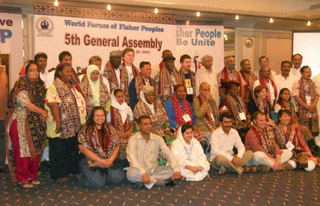

Slide 6
OUR CHALLENGES AS A GLOBAL MOVEMENT
Blue Economy / Blue Transformation as the development paradigm of the fisheries sector which devastate, destroy and displaced fishing communities
Repressive regimes take measures to curtail our leaders using their oppressive mechanisms and criminalization against them,
Uniting and keeping close coordination, communication, cooperation among diverse cultures, diverse languages, diverse geographical regions, diverse identities and diverse practices as a challenge to have convergences,

Slide 7
WE ARE UNITED AMONG DIVERSITY
Coordination with national SSF member Organizations,
Promote Gender Justice through Equal participation and representation of Women,
Formation of regional for a- LAC, Africa, Asia and the Pacific, and Europe to strengthen and to address issues collectively,
Regular coordination among the coordination team, and promotion of collective and young leaders in the Movement,
Continuous and touching bases on daily basis among the Leadership team, the Co-Coordinators, General Secretary and the Treasurer, and take decisions appropriately and timely.
Network with the Global and Regional movement which are focus Food Sovereignty, Agro-Ecology, Agric/ Aquatic Reforms,
Respect traditional knowledge and practices to address issues faced by SSF

Slide 8
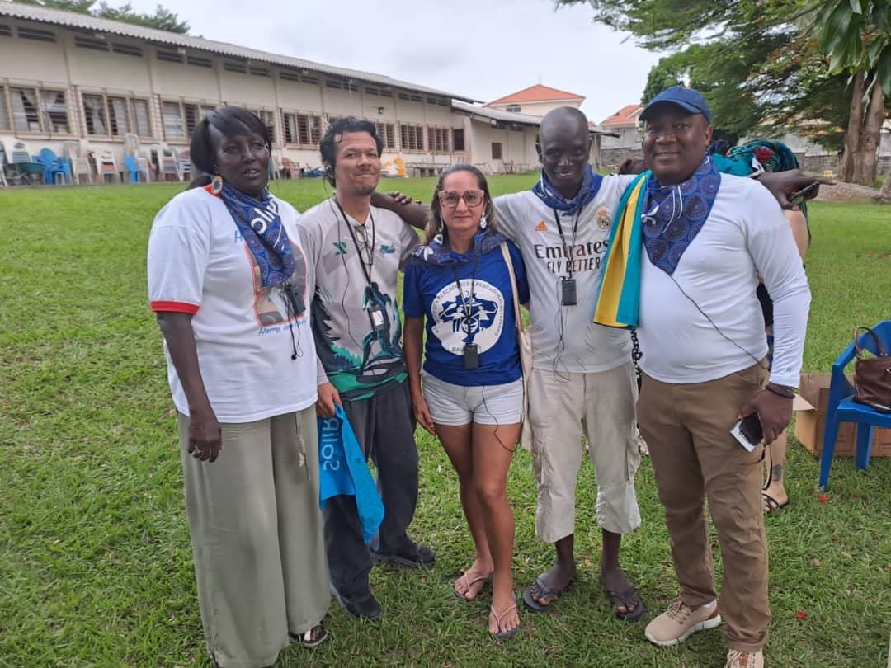
PROMOTION OF YOUNG LEADERS IN THE MOVEMENT

Slide 9
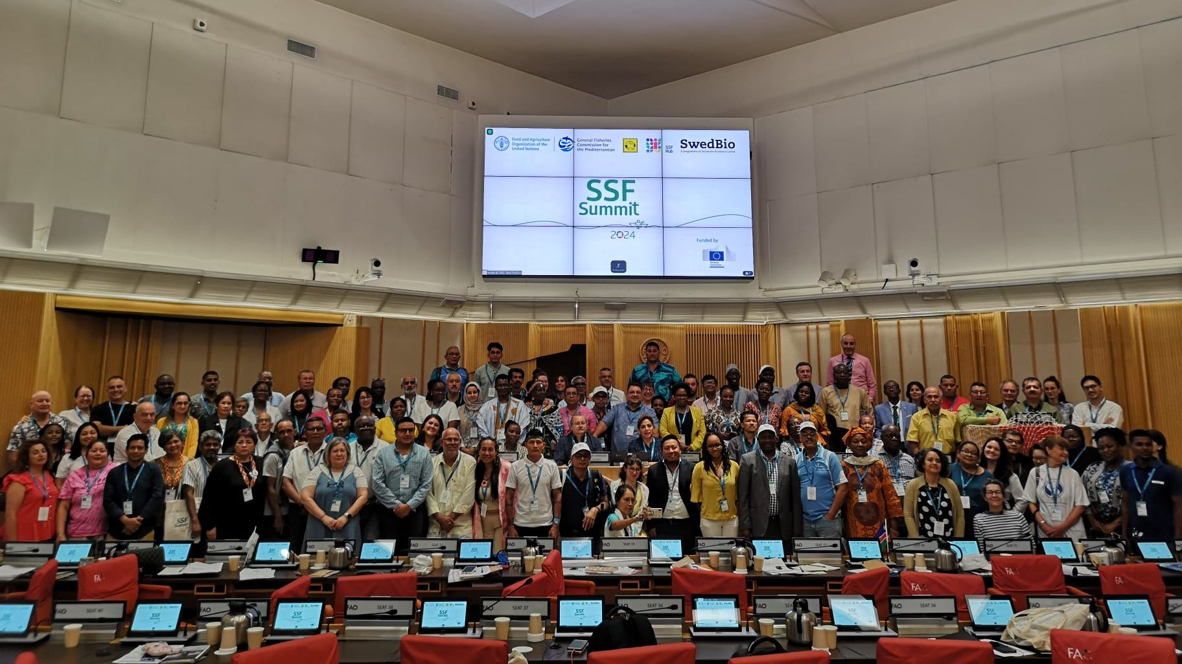
COLLABORATE AT ALL LEVELS ON SSF ISSUES

